Slide 1
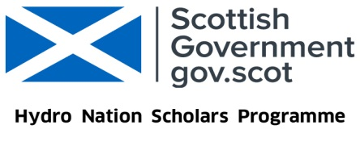
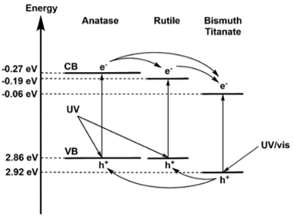
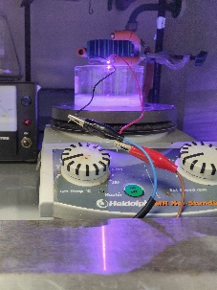
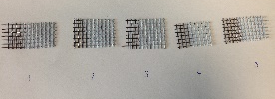

Water Purification in Rural India using Sunlight and Low-cost Materials
Victoria Porley
School of Chemistry, University of Edinburgh v.e.porley@sms.ed.ac.uk www.hydronationscholars.scot
Introduction
In order to find a method of water purification that allows water to be accessible to those who are most in need, that system must be low cost, robust, and simple.
Photocatalysis is a potential candidate for this system, if it can be suitably optimised.
Methods
Improve photocatalysis with TiO₂ by investigating the best supports, including glass, stainless steel, titanium, plastics and fabrics.
Use model organic pollutants and cultures of E.Coli to test purification activity of prepared catalytic films using various reaction conditions.
Results
Adhesion of the catalyst to the support is greatly improved when mixed with a polymer and when the support is roughened through pre-treatments.
Testing on real-world sample showed the process degraded aromatics to aliphatics when using TiO₂ modified with bismuth titanate (BTO)
Future
Will travel to India with catalyst samples to conduct testing in real-world conditions
This knowledge will be used to continue to optimise the material and reactor system implemented
Acknowledgements: Supervisors Prof. Neil Robertson and Dr Efthalia Chatzisymeon, as well as the whole Robertson group, Hydro Nation, IIT Kharagpur, ATREE and IISc Bangalore

